Slide 1

Rabies Accessible Genomic Epidemiology (RAGE)
Kirstyn Brunker
RAGE opening ceremony
Abuja, Nigeria
12th Feb 2024

Slide 2
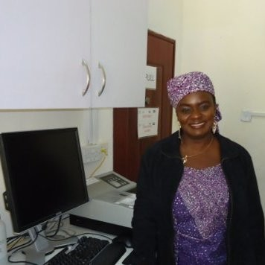

Dr Grace Kia

Slide 3

RAGE
enomic
pidemiology
Image: HudsonAlpha.org

Slide 4

What is genomic surveillance?
Monitoring and analysing genetic data from pathogens to understand how they're changing, where they're spreading, and how to stop them from causing more harm.

Slide 5
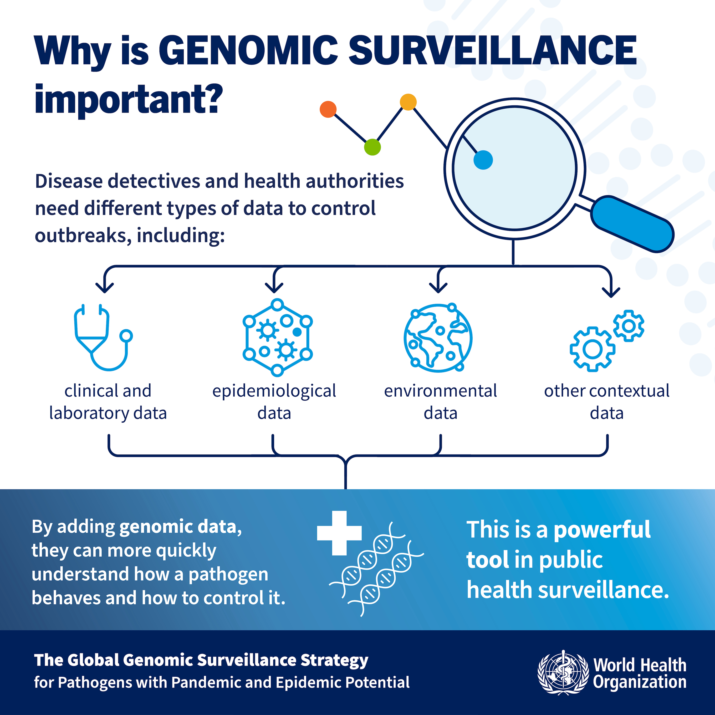

Slide 6

From Academic Luxury to Indispensable Tool
Image: PAHO
Notes:
Sequencing has really become an important component of pathogen surveillance
Cost-effective, accessible, deployable
It’s less of an academic luxury where outbreak data is retrospectively analysed
To indespensibsle tool being used - seq in situ, in real-time. Actively inform decision making
Over last 5 years or so application come to the fore...being applied to ebola.. and particularly with COVID , Come to the fore
Capactiy for genomics: there is an imbalance
while it's become more routine in high income countries, it's less established in low and middle income countries
Opportuntiy to Drive improvements in emerging disease surveillance through locally relevant capacity strengthening that targets endemic zoonotic diseases: plenty around, ever present, constantly eating away, significant burden on communities

Slide 7

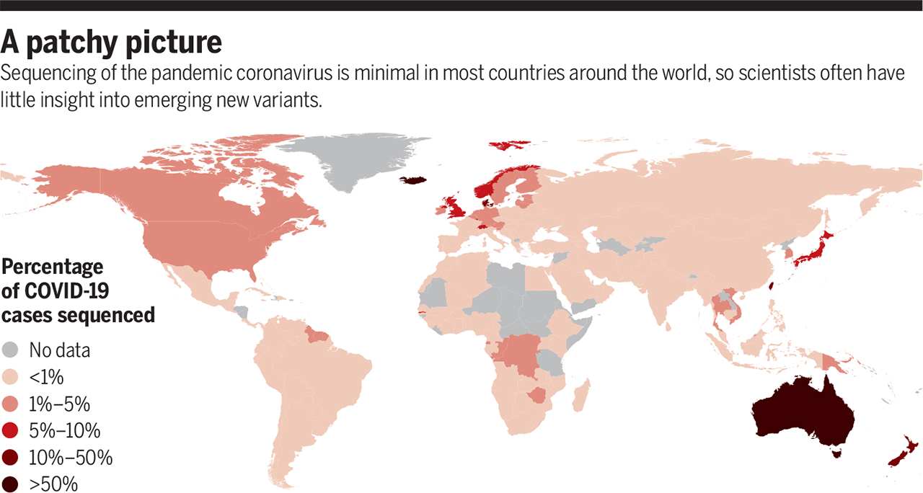
Blind spots thwart global coronavirus tracking, Volume: 372, Issue: 6544, Pages: 773-774, DOI: (10.1126/science.372.6544.773)
Notes:
Global disparities in capacity for genomic surveillance and this creates problems when it comes to interpreting something that is a global health problem. There are hotspots of sequencing activity that tally in with the areas where it was already widely used and had already significantly invested in the infrastructure having recognized its potential. pockets where sequencing was and this creates problems when it comes to interpreting something that is a global health problem

Slide 8
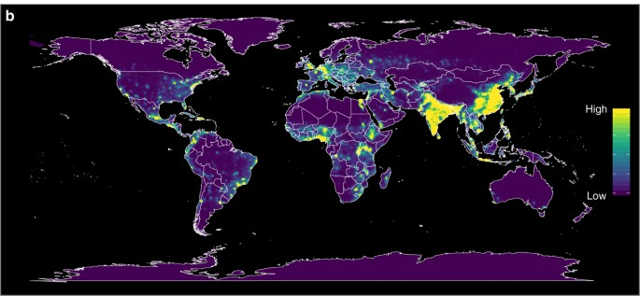
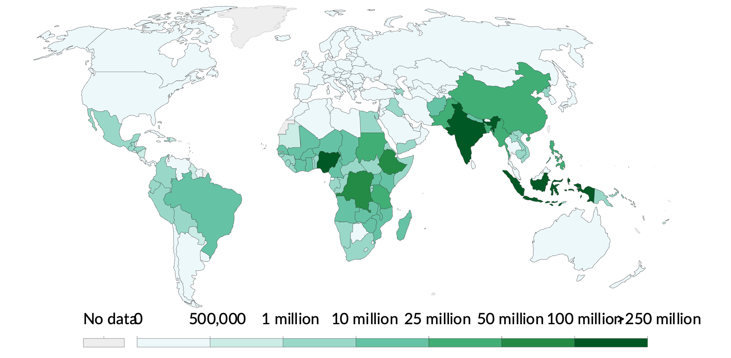
Blind spots in the areas where we need the greatest visibility
Emerging disease risk map
Allen et al. Nat Commun 8, 1124 (2017)
Number of people requiring interventions against neglected tropical diseases (NTDs) , WHO
Notes:
Blind spots in the areas where we need the most visibility
Highest risk of zoonotic disease emergence…
where there is the least capacity for genomic surveillance

Slide 9

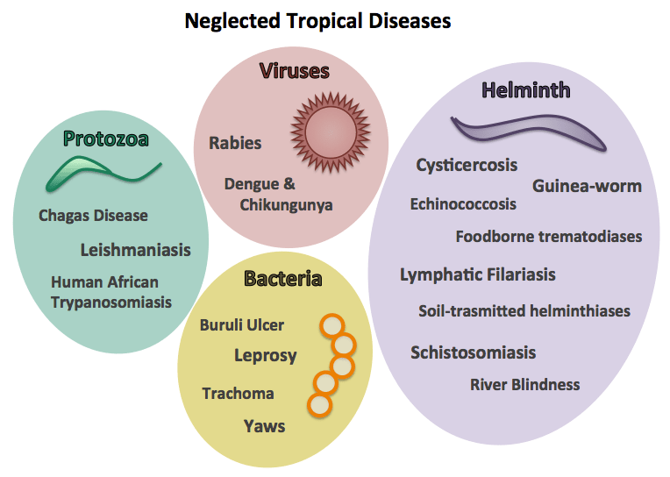
Hiding in plain sight
?
“Indiscriminate weapons of mass destruction in slow motion”
Notes:
Affect 1.7billion people worldwide
debilitate, disfigure and can be fatal
Investment build robust community health systems that have been effectively leveraged
Bang for your buck | Hit global health development targets
Typically have effective interventions available e.g. mass drug administration, well defined targets and measurable impacts. Can leverage existing networks.
They also have regional importance and along with providing a platform for filling in gaps in capacity, can have a positive feedback loop for affected communities
Many of these are zoonotic and therefore can provide important platforms for One Health research and understanding pathogens at the human-animal interface (where most pathogens emerge)
2021–2022 period also saw several outbreaks of NTDs, including dengue, chikungunya, leishmaniasis and scabies

Slide 10
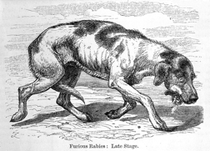
RAGE
abies
“La rage”
enomic
pidemiology

Slide 11
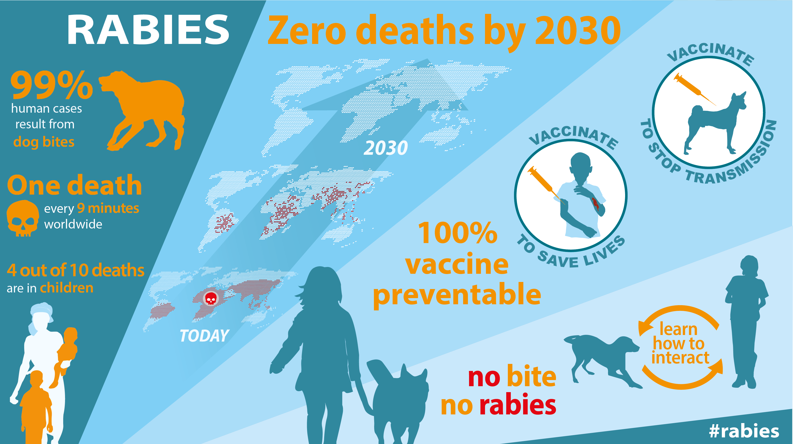

Slide 12
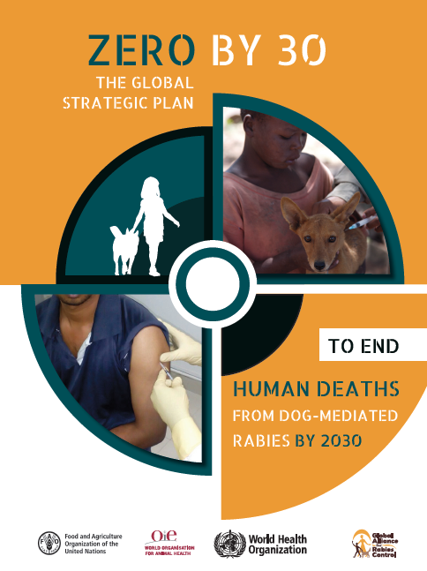
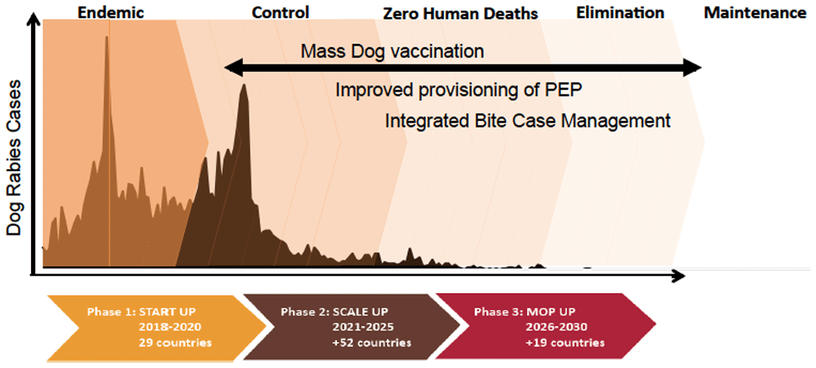
The road to elimination: how genomics can help
Understanding processes critical to persistence
Track lineage dynamics as rabies is controlled
Discriminate host variants
Cryptic transmission or incursions
Verify freedom from dog-mediated rabies
Notes:
Part of enhanced surveillance that will be needed to establish and maintain elimination

Slide 13










Variants and cross species transmission
Outbreak
Cryptic circulation?
Introduction?
Monitor impact of interventions
Drivers

Slide 14
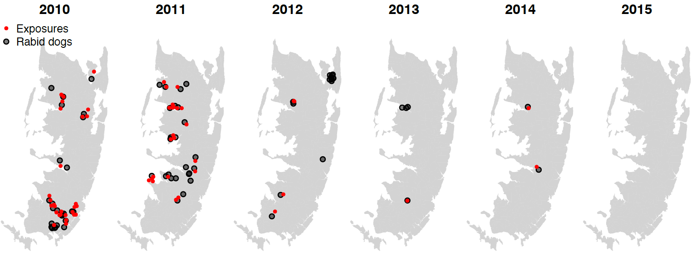

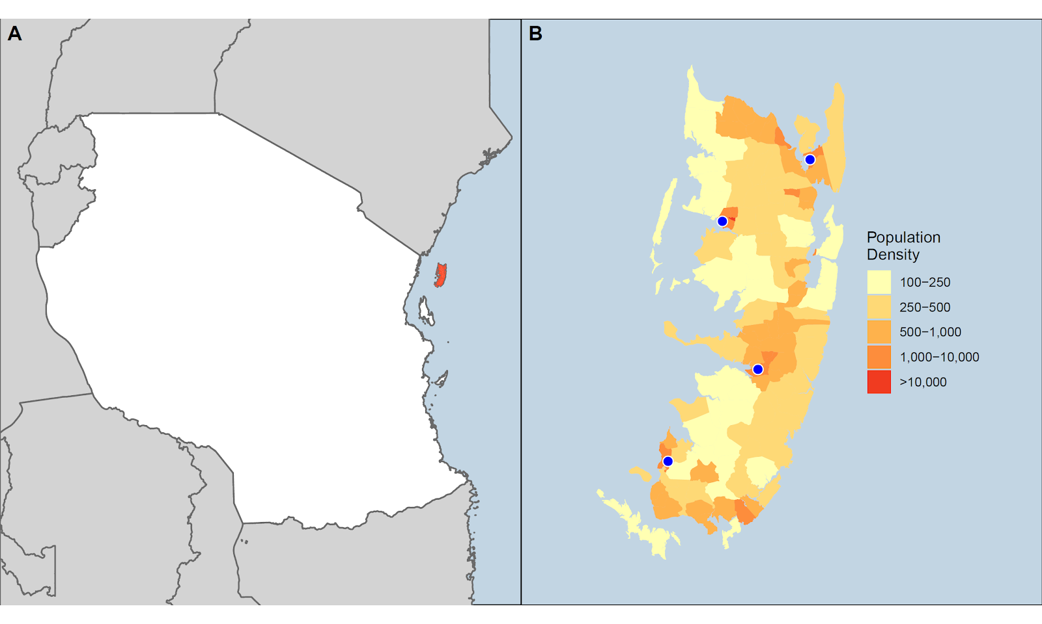
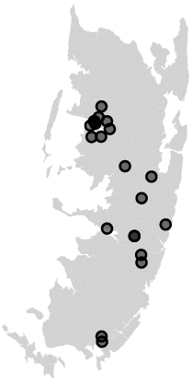


Understanding Rabies on Pemba: A One Health Approach
Outbreak
Tanzania
10 km
~4,000 dogs
Rapidly sequenced outbreak cases in-country
Lushasi/Brunker et al (2023), Elife

Slide 15
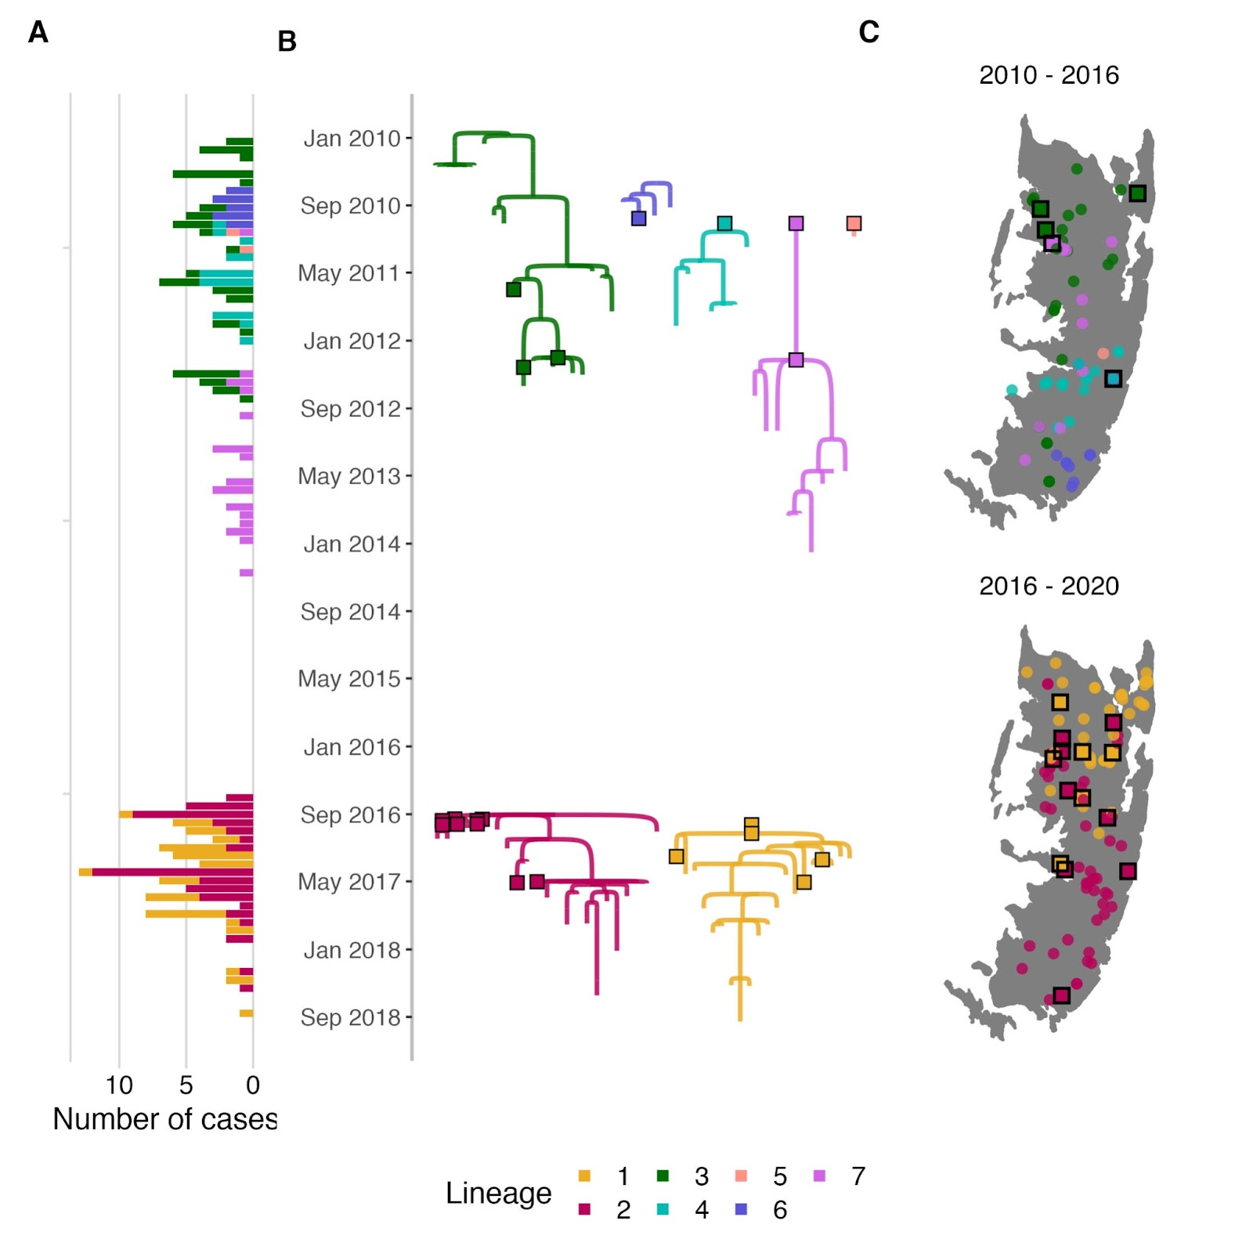
Endemic period (2010–2014)
2 years no detected rabies cases
Outbreak (2016–2018)
Notes:
Transmission trees from contact tracing, dispersal kernel and a serial interval distribution, corrected by phylogenetic assignments
2 independent incursions from mainland Tanzania
- Not related to previous RABV diversity

Slide 16
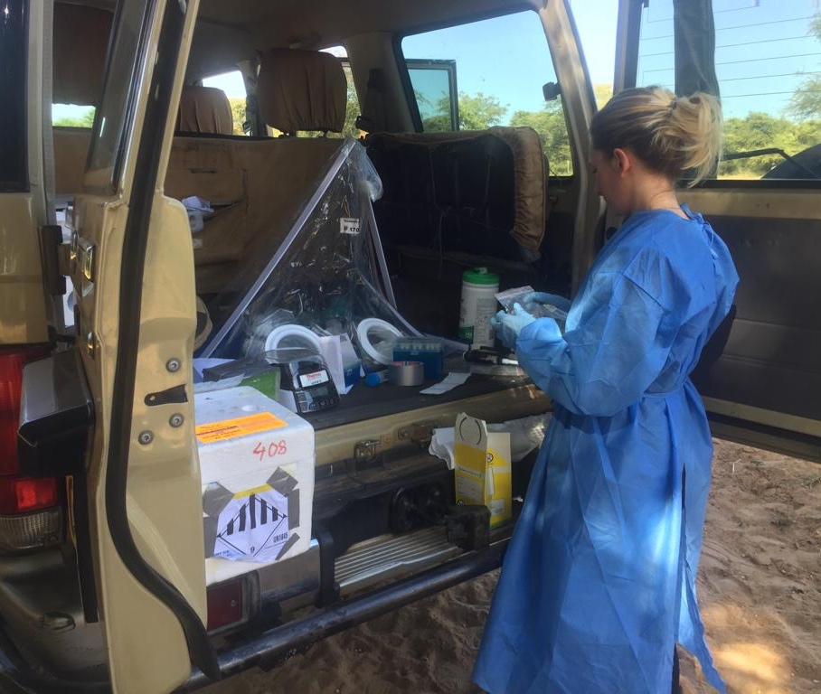
RAGE
abies
ccessible
enomic
pidemiology

Slide 17
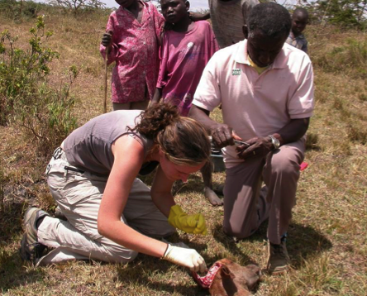

The usual situation
Sequencing provider
Answer
3-6 months

Slide 18
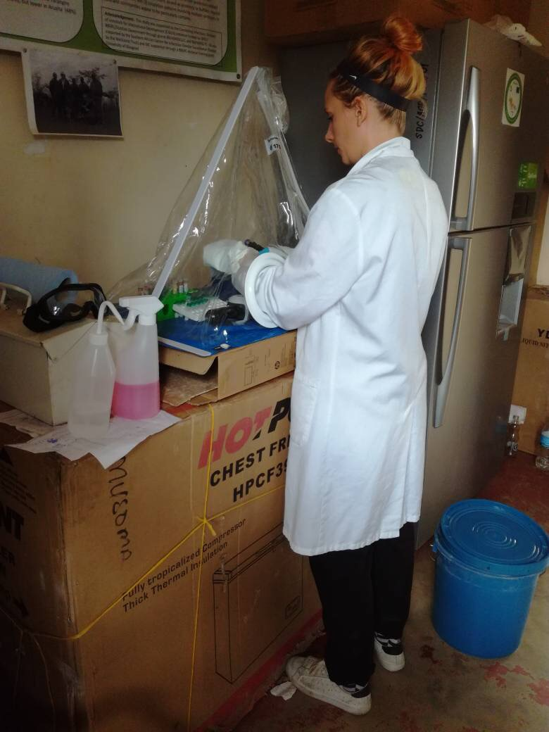




Taking the lab to the sample
ATGTCATGGCTTTTAGATTGCCAATGATGATTGGCTTAGGGGCATAGTAGC
Result in days
Brunker et al (2020), Well. Open Res.; Bautista et al (2023), JoVE.

Slide 19
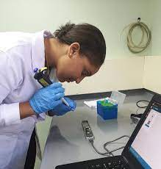
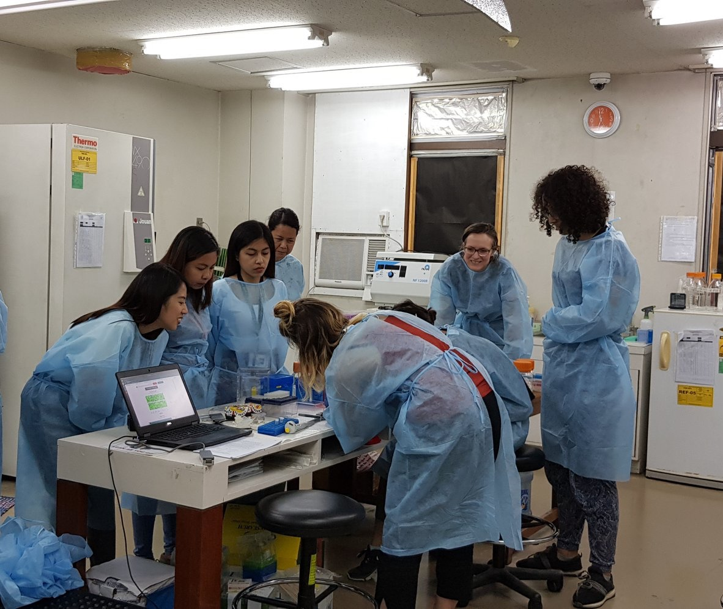
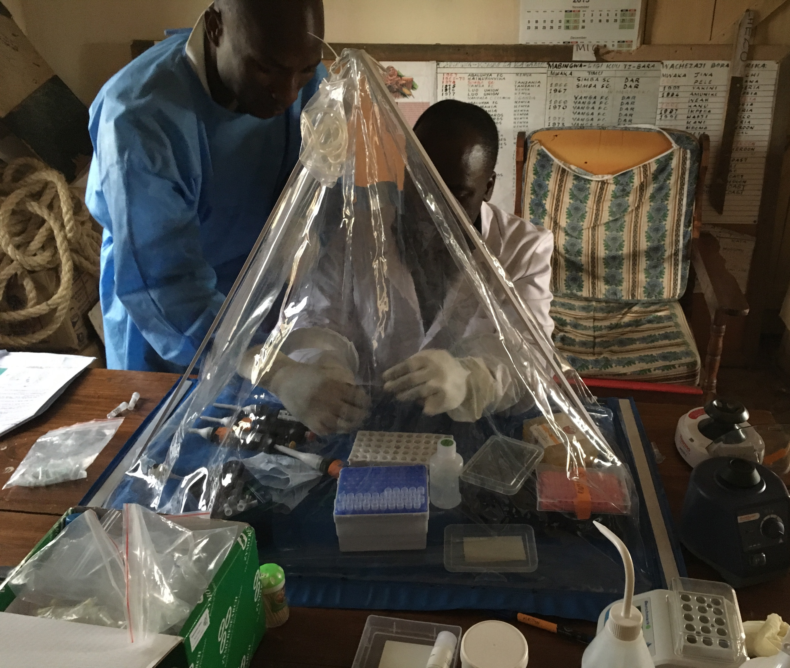

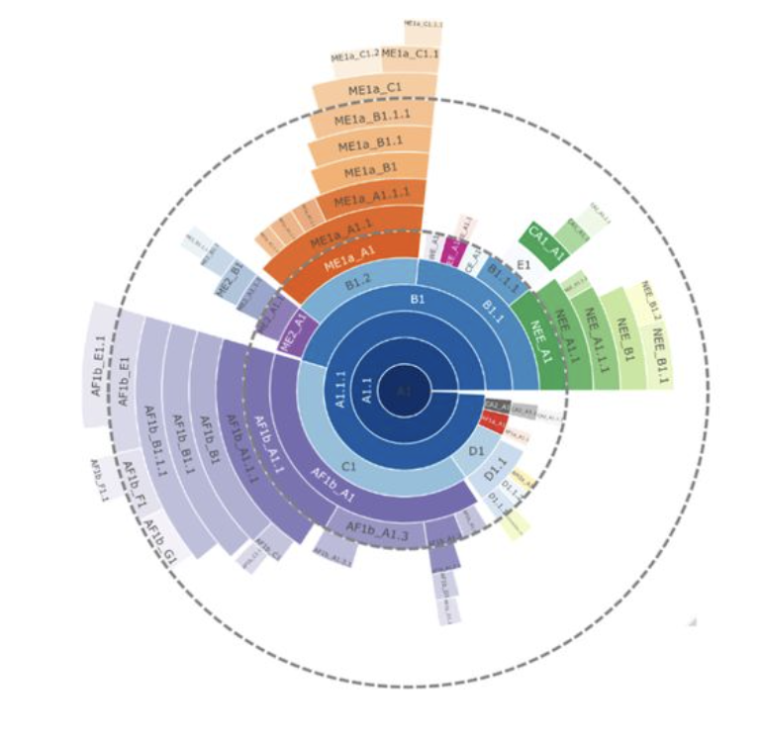

Slide 20

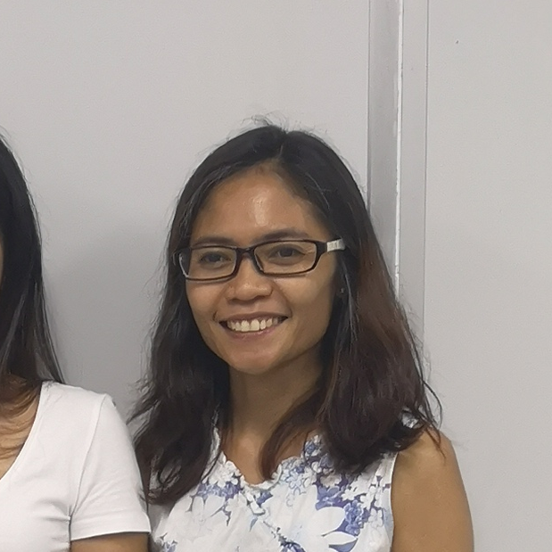


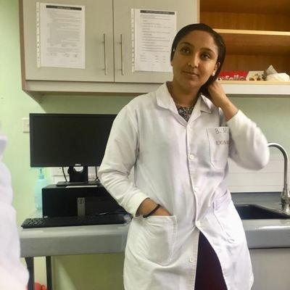












In-country sequencing
In-country sequencing
Nigeria
Philippines
Kenya
Tanzania
Peru
Malawi

Slide 21
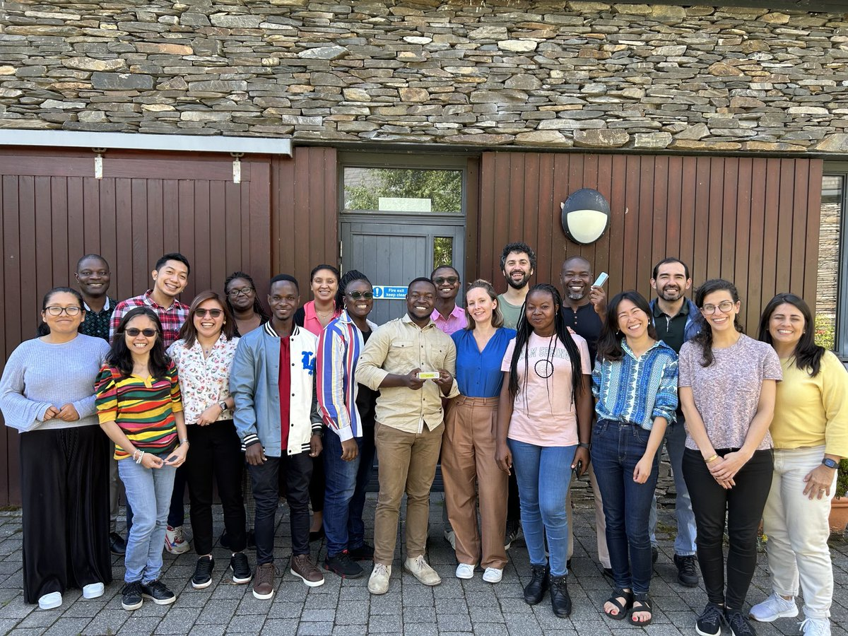

Slide 22


Slide 23
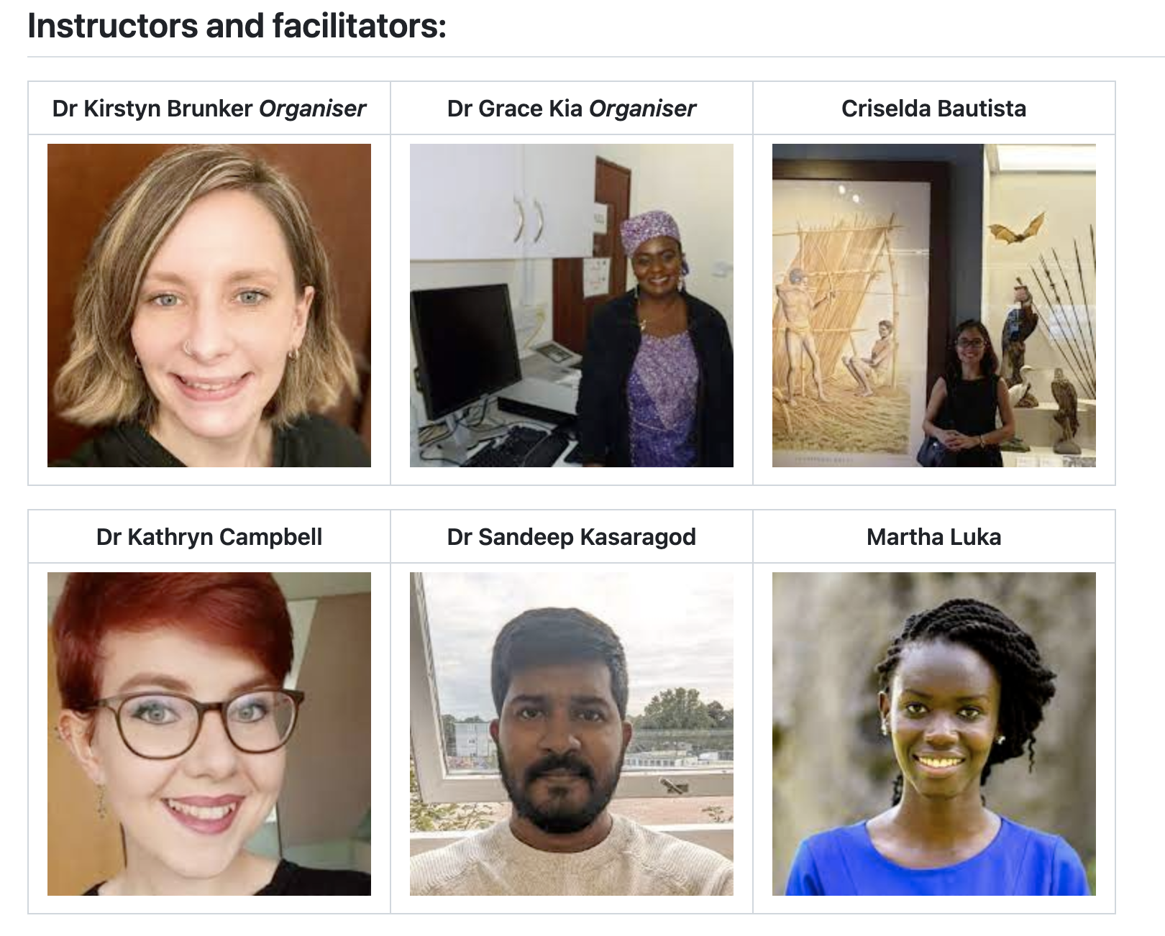
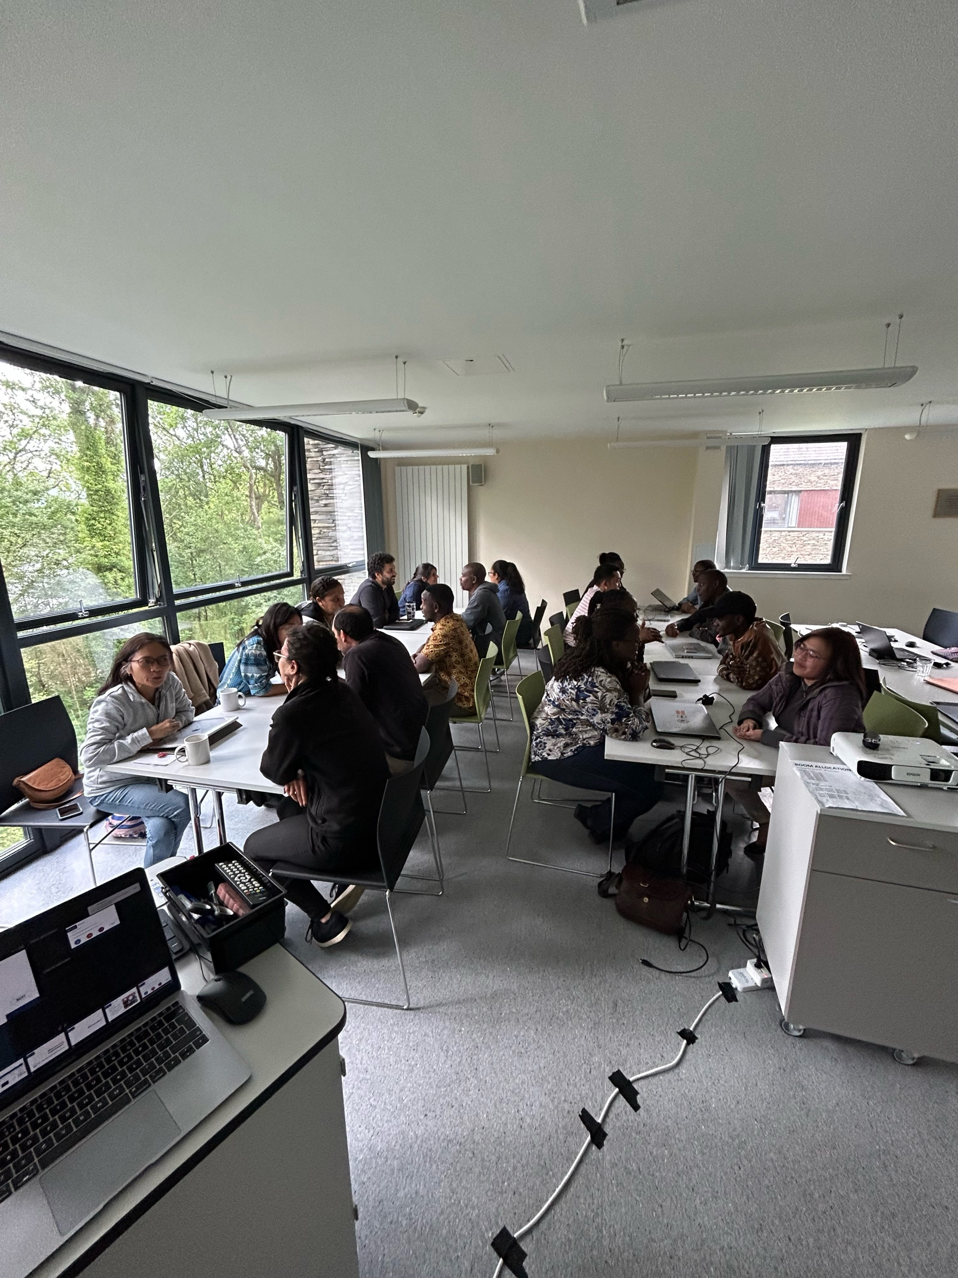
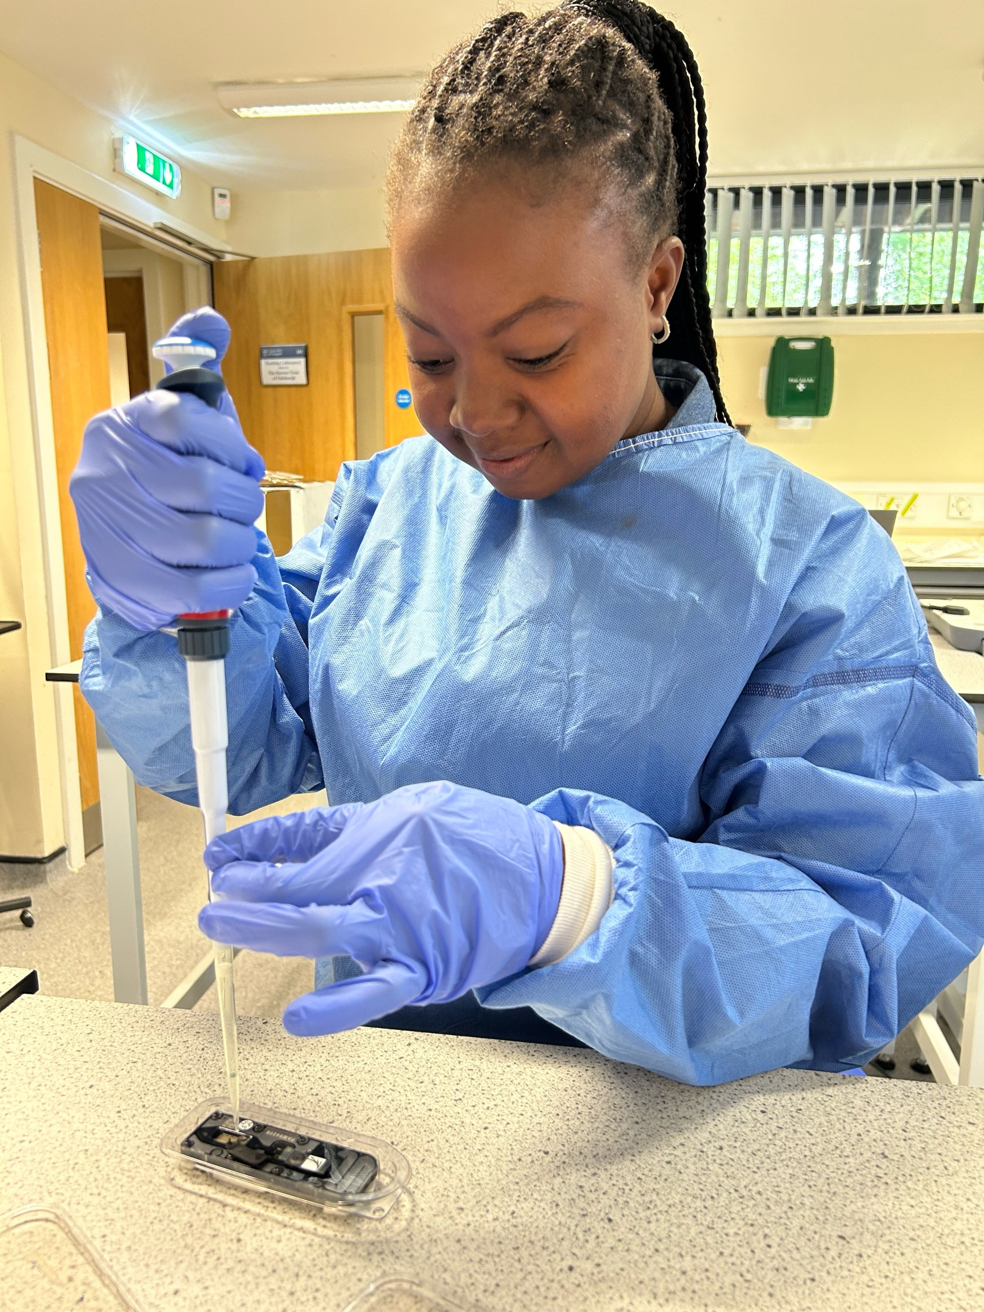
RAGE training in Nigeria

Slide 24

Acknowledgements
University of Glasgow
Katie Hampson & research team
Criselda Bautista (PhD student)
Kathryn Campbell
Sandeep Kasaragod
Smitha Abraham
Martha Luka
Rowan Durrant
Ahmadu Abello University, Zaria
Grace Kia
Agatha Ukande
Nsadzetsen Gilbert Adzemye
Dickson Anoibi Mathew
Agatha Ukande Seember
Nigerian Centre for Disease Control- Public Health Laboratories
MRC-University of Glasgow Centre for Virus Research
Joseph Hughes
Afrida Mukaddas Mannan Cadiyan
David Robertson
Stellenbosch University
Rob Gifford
UK-Philippines MRC-SPEEDIER
Betsy Miranda
Daria Manalo
Nai Rui Chng
RITM, Philippines
Daria Manalo
Tim Dizon
Dodge Lim
Mayan Lumandas
Paco Polotan
KEMRI-Wellcome Trust/
Washington State University, Kenya
Thumbi Mwangi
UNITID, Nairobi
Tanzania rabies team
Gurdeep Jaswant (IHI,Uni Nairobi/Glasgow) (PhD student)
Kennedy Lushasi (IHI)
Anna Czupryna
Ahmed Lugelo (SUA)
Joel Changulanga IHI)
GEMVI
James Nokes
Nelson Mandela African Inst of Science &Tech
Joram Buza
Beatus Lyimo
Tanzania Veterinary Lab Agency
Chanasa Njeleja
Julius Mwanandota
Ifakara Health Institute
Sokoine University of Agriculture
Animal & Plant Health Agency
Lorraine McElhinney
University of Surrey
Daniel Horton
Denise Marston
University of Pennsylvania/Universidad Peruana Cayetano Heredia
Ricardo Castillo-Neyra
Renzo Salazar Sanchez
Melina Vargas Maquera
Claudia Chipana Ramos
Gerencia Regional de Salud de Arequipa
Ynes Monroy
Edith Zegarra
ARTIC network
The End
Kirstyn.brunker@Glasgow.ac.uk

